Slide 1
Intermediate Python (work in progress)
Teachers: Dmitry Nikolaenko, Samantha Finnigan
Assistant: Jordan Byers
Advanced Research Computing, Durham University
May 9, 2023 (preliminary date)
Notes:
<number>

Slide 2


Welcome and icebreaker
Thank you for joining!
2-hour course (10am-12pm); break for 10 minutes around 11am
Mute when not talking, but please do post in the chat or speak up when questions arise
Introductions (post in the chat)
Link to the exercises for today: https://colab.research.google.com/github/DurhamARC/Intermediate-Python/blob/main/exercises/intermediate_python_exercises.ipynb
Notes:
<number>

Slide 3
Course structure
'Beginners Python’ refresher
Loops, lists, functions
‘Pythonic’ concepts
List comprehension, ternary expressions, *args and **kwargs
Lambdas
More advanced string manipulation
Introduction to modules and packages
Data structures and containers
Mutability
Brief introduction to classes
Notes:
<number>

Slide 4
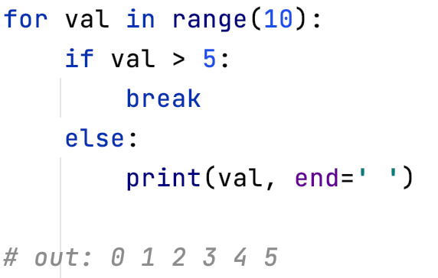
Recap (a): Control Flow
Conditional statements: if, elif, else
Loop statements: for, while
break, continue statements
How would the example’s behaviour differ if break was swapped for continue?
Notes:
<number>

Slide 5
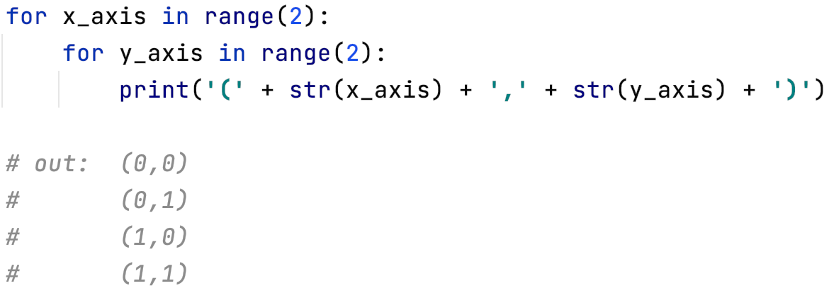
Recap (a) cont.
Nested loops
Notes:
<number>

Slide 6
But what is the for loop doing under the hood?
Notes:
<number>

Slide 7
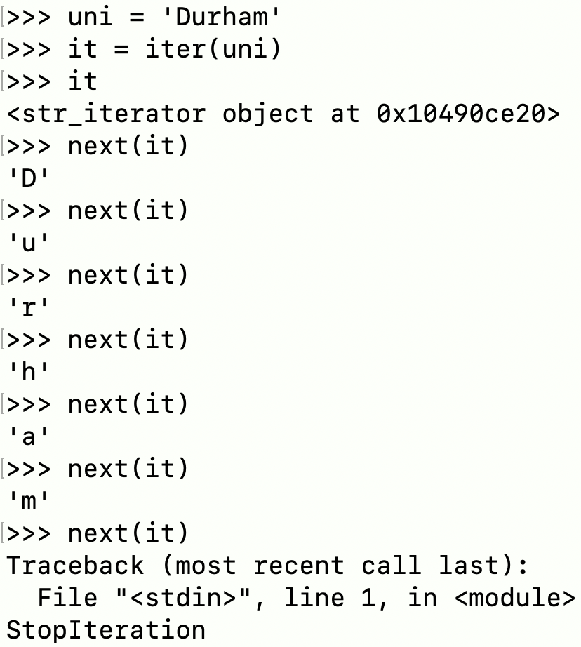
Control Flow (iterators)
iter() is called on the container object
This returns an iterator object
The iterator object defines a __next__() function
Facilitates access of elements one at a time
__next__() tells for loop when there are no more elements (raises StopIteration exception)
Notes:
<number>

Slide 8
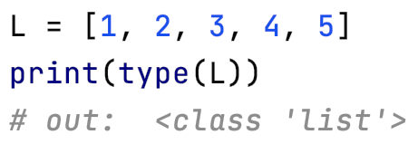
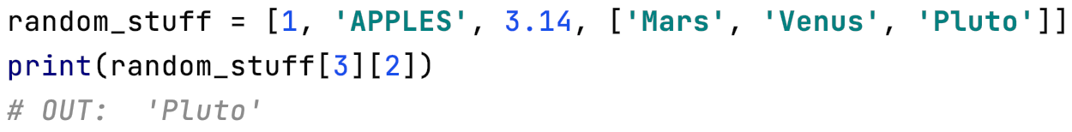
Recap (b): Lists
Quick and easy way to store objects
Can contain objects of any type, or even a mix of types
Python’s dynamic type system makes things easy!
Notes:
<number>

Slide 9
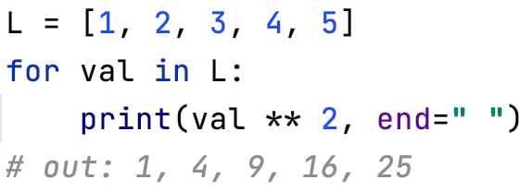
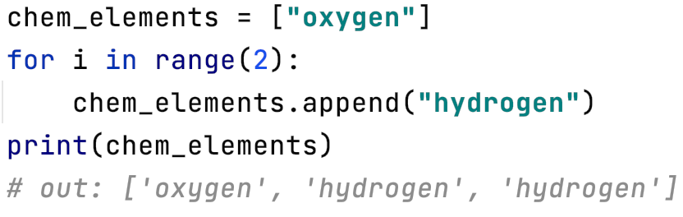
Recap (b) cont.
Easy to process lists using for loops
Appending to lists
Notes:
<number>

Slide 10
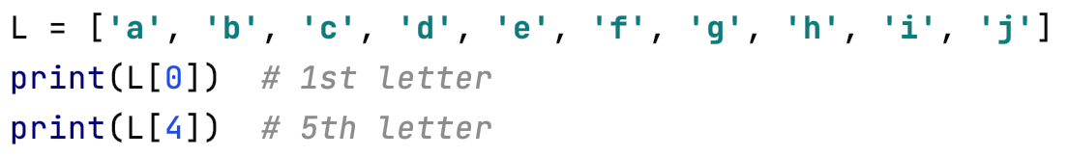
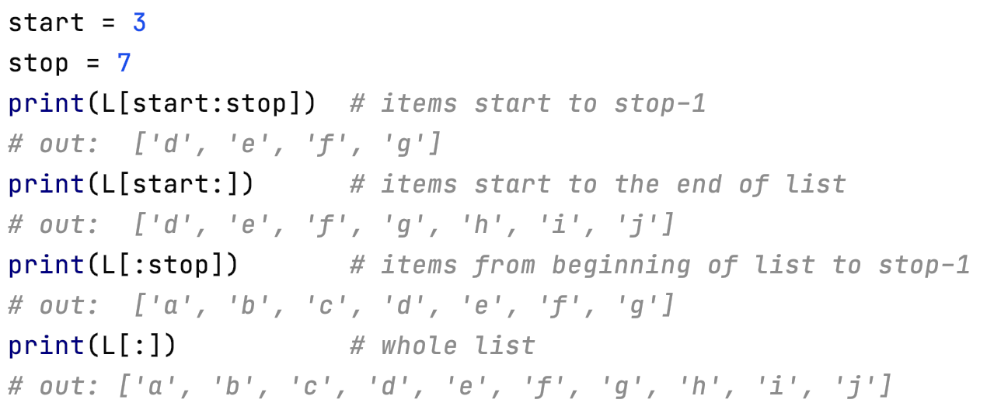
Recap (b) cont.: Semantics of slicing
Simple to grab object in list if you know where it sits:
Use : to grab a range defined subsection of the list (slicing):
Key - the :stop value represents the first value not in the slice
Notes:
<number>

Slide 11
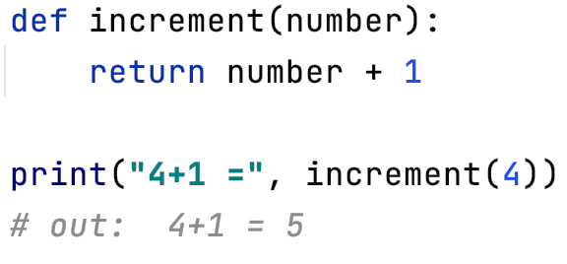
Recap (c): Functions
Principle of encapsulation
Enable maintainability and readability alongside complexity
Reusable code
The def statement
The importance of indentation
The return statement
Notes:
<number>

Slide 12
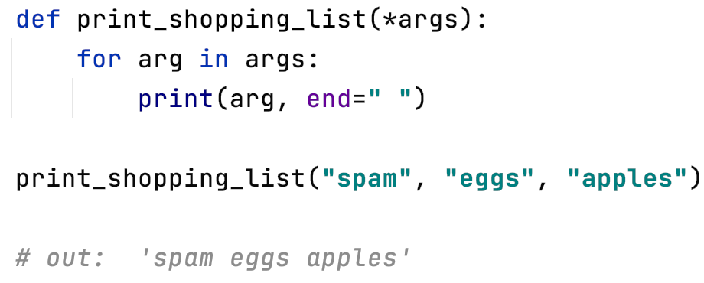
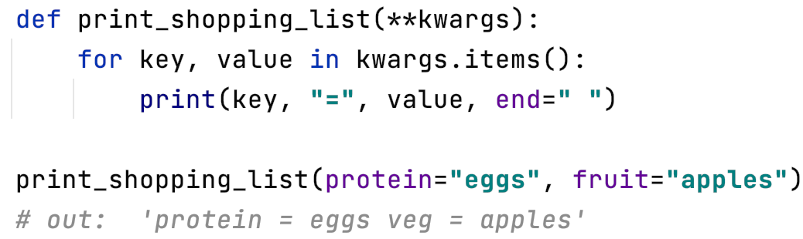
Building on the above (a)
Notice: python functions can initialize multiple variables upon return
*args and **kwargs
*args for non-keyworded variables
*kwargs for keyworded variables
Notes:
<number>

Slide 13
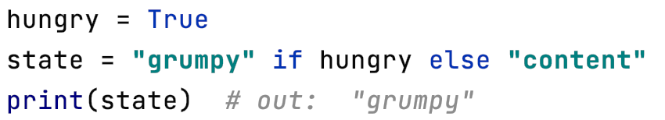
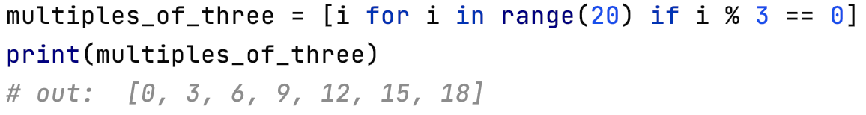
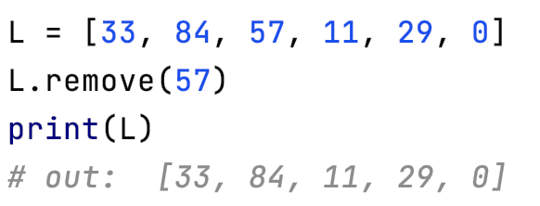
Building on the above (b)
Ternary expressions
List comprehension
Inbuilt functions that come with list
(We’ll see more in the next slide)
Notes:
<number>

Slide 14
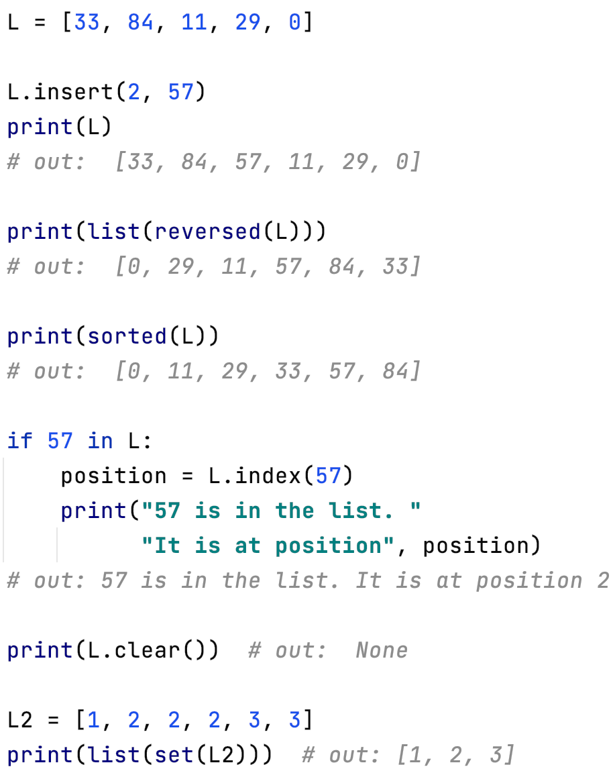
More inbuilt list functions
Inserting an element
Reversing
Note: reversed() returns a ‘reverse iterator’ that then needs to be turned back into a list with list()
Sorting
Searching
Emptying
Removing duplicates
Notes:
<number>

Slide 15
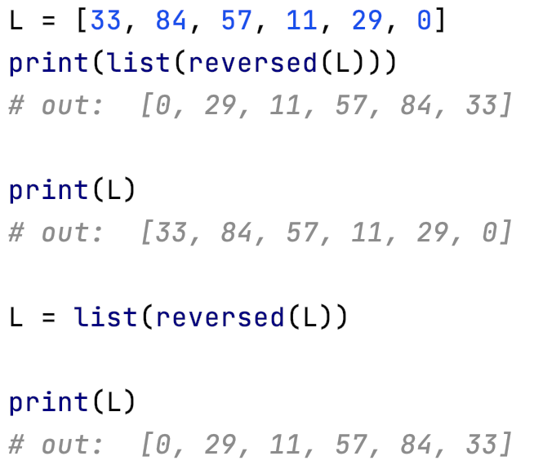
Important distinction
e.g.
L.empty()
Some of these functions actively modified our list while others returned a copy of the modified list, leaving the original list untouched
So, to reverse our list permanently with reversed() we must use assignment
All reversed() does is return a reverse iterator!
Notes:
<number>

Slide 16
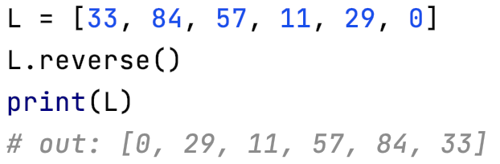
Better still…
To avoid the explicit copy and assignment operations (potentially expensive) use reverse() instead of reversed()
Unlike reversed(), reverse() is a member function of the list itself
No single way is right: coding is about making good choices
Notes:
<number>

Slide 17
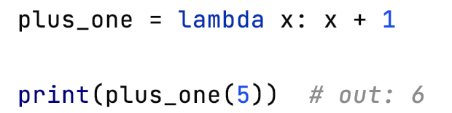

Building on the above (c): lambda functions
Lambdas (sometimes anonymous functions) are one-line functions.
Useful when you don’t want to use a function twice
Blueprint: lambda arguments : expression
Lambdas can be used to pass around functionality as we will see next…
Functionally equivalent to
Notes:
<number>

Slide 18
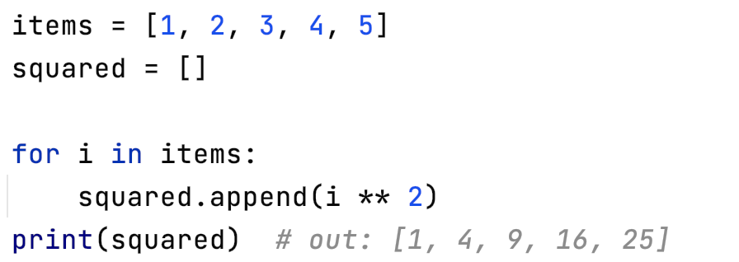
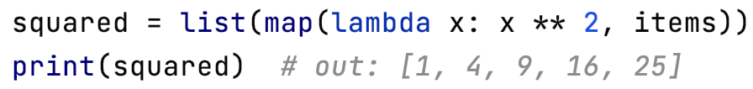
Lambda functions (continued)
Map applies a function to all the items in a list_of_inputs.
map(function_to_apply, list_of_inputs)
Where previously we would write:
Now this can be simplified to:
Notes:
<number>

Slide 19
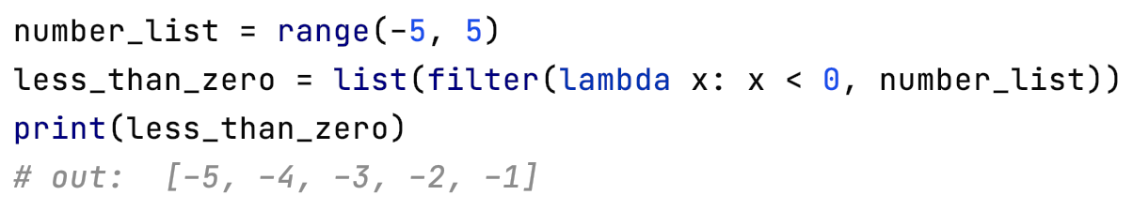
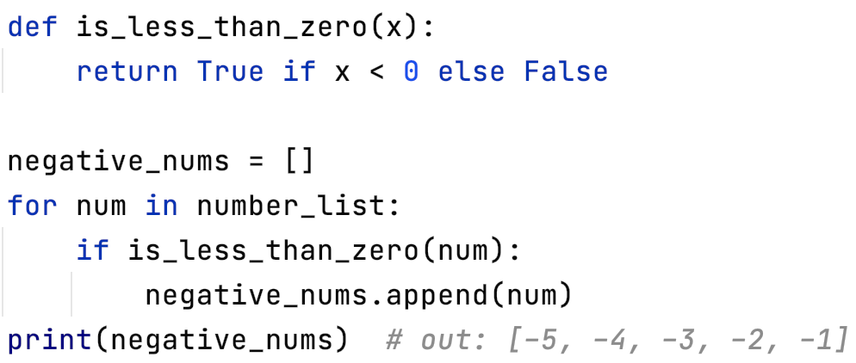
Lambda functions (continued)
Filter creates a list of elements for which a function returns true:
Equiv. non-lambda expression:
Notes:
<number>

Slide 20
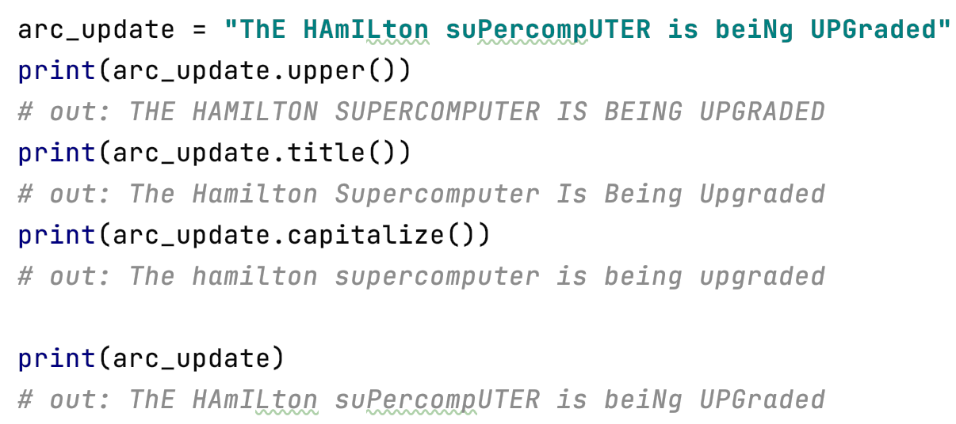
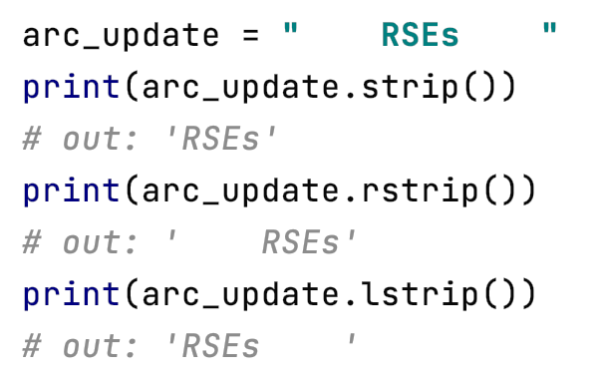
Mastering strings (a)
Adjusting case
Formatting strings
None of these functions modify the original string. Instead, they return a copy. Modification requires assignment.
Notes:
<number>

Slide 21
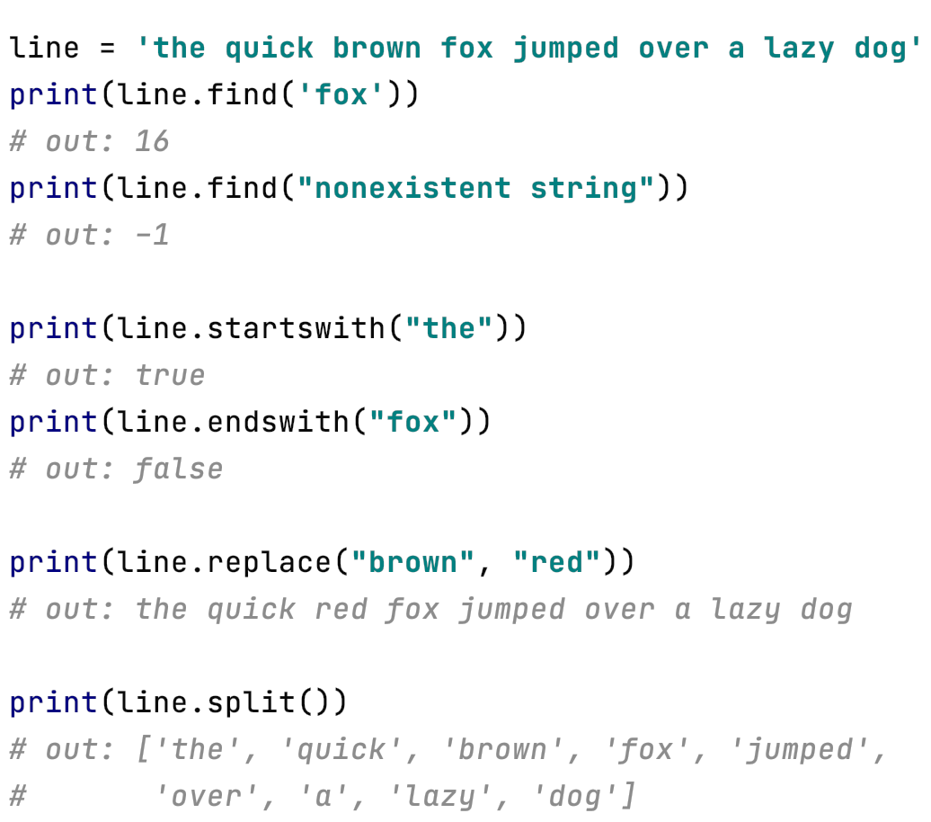
Mastering strings (b)
find(): return index of a substring
Returns -1 if substring not found
Querying the existence of
Replacing, splitting
Notes:
<number>

Slide 22
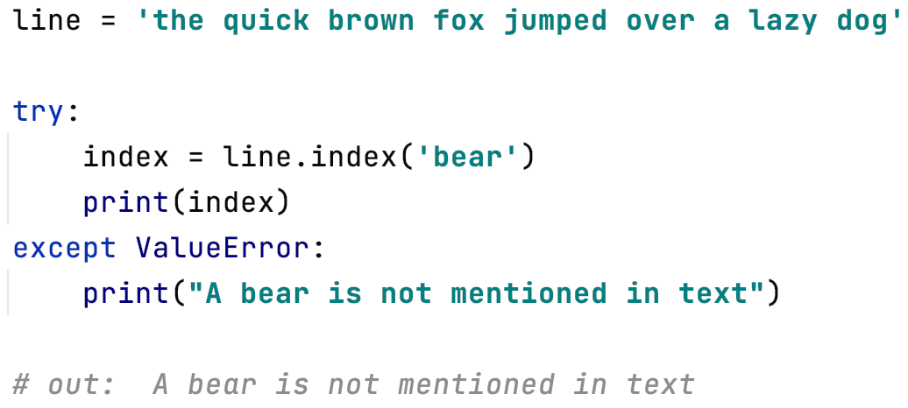
Mastering strings (c)
Index() is similar to find()
Returns index of substring
However, unlike find(), index() raises a ValueError exception when substring not found
Used alongside exception handling
Notes:
<number>

Slide 23
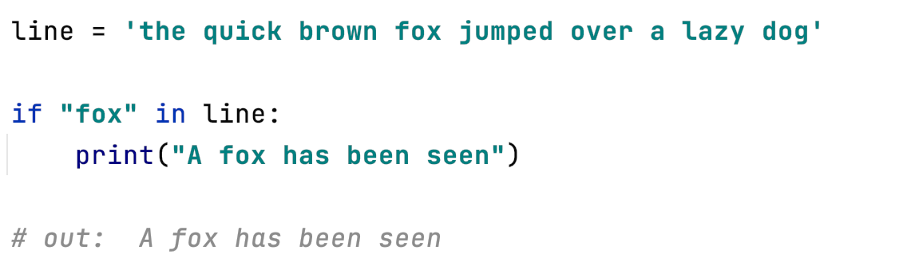
An aside:
The canonical way to search a string (if not interested in the index) is very simple:
Notes:
<number>

Slide 24
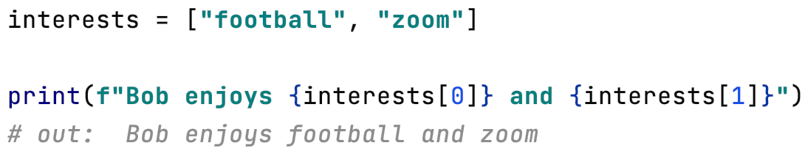
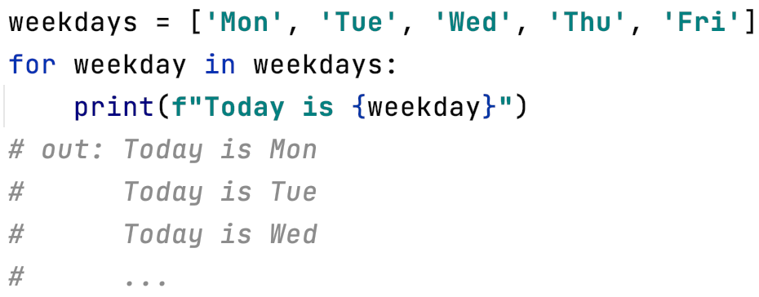
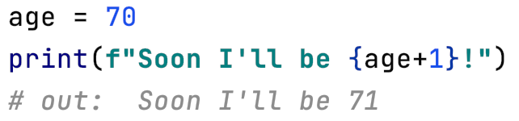
Mastering strings (d)
F-strings
F-strings provide a way to embed expressions inside string literals, using a minimal syntax
The expressions are evaluated at runtime and replaced with their values
Notes:
<number>

Slide 25
Exercises
Ask us questions!
We’re very happy to setup breakout rooms upon request
Notes:
<number>

Slide 26
Coffee break
Notes:
<number>

Slide 27
Introduction to modules and packages
Notes:
<number>

Slide 28
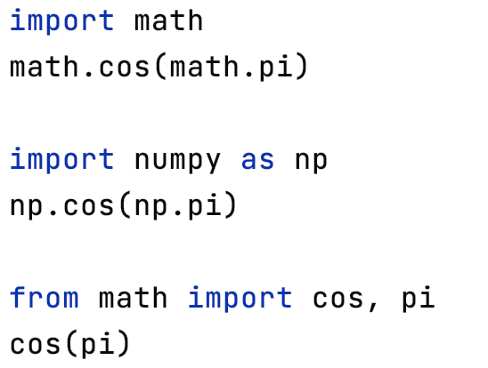
Namespaces
Modules and packages
Loading modules: the import statement
Explicit module import
Explicit module import by alias
Explicit import of module content
Notes:
<number>

Slide 29
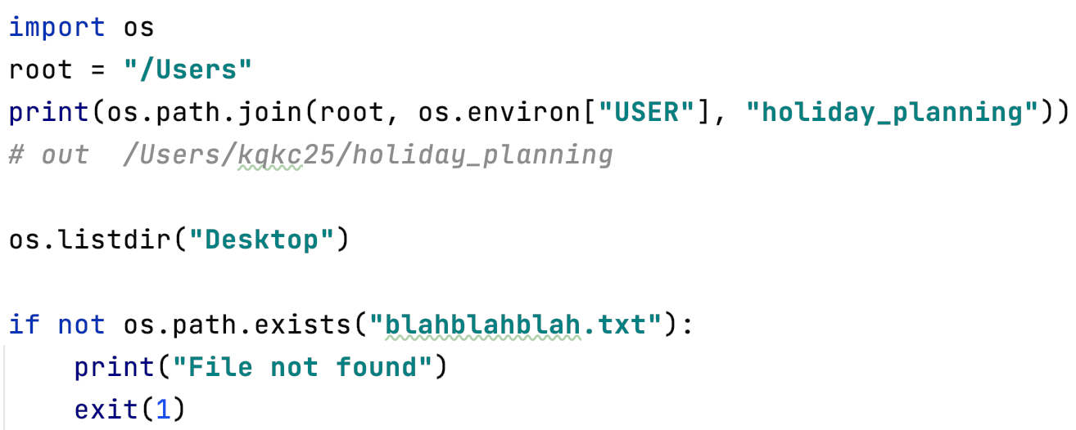
Other useful modules in the standard library
Facilitates portability
Tools for interfacing with the operating system: os
Very useful when processing multiple data files
Notes:
<number>

Slide 30
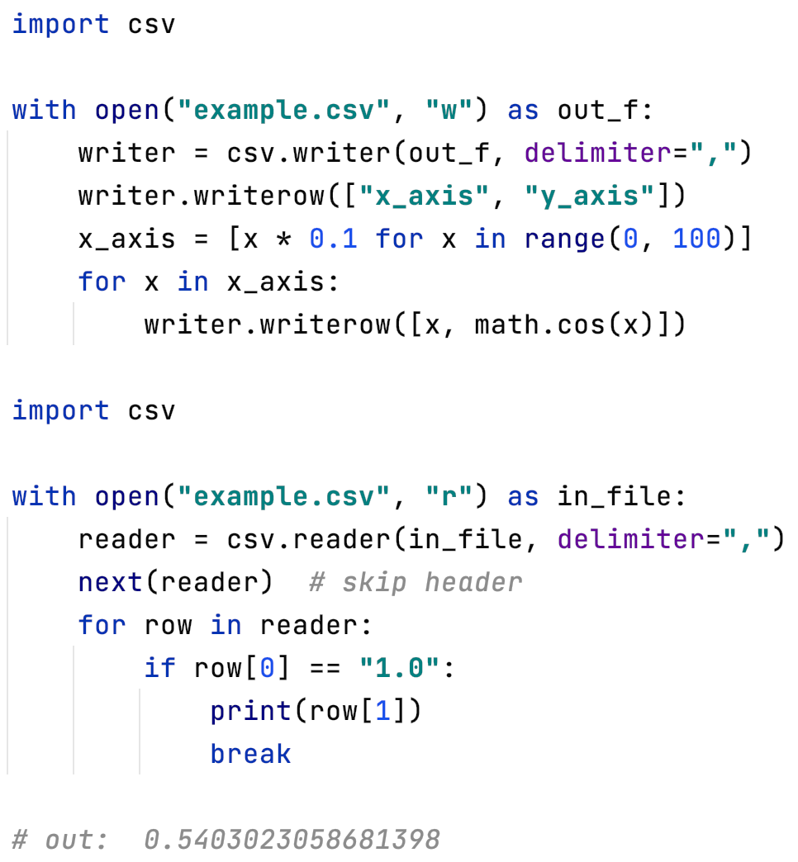
Using the csv module (part 1)
Very convenient module for parsing and writing csv files
Writing a csv
Notes:
<number>

Slide 31
For the sake of visualization, here is the first part of the csv we just made:
x_axis | y_axis
0 | 1
0.1 | 0.99500417
0.2 | 0.98006658
0.3 | 0.95533649
0.4 | 0.92106099
0.5 | 0.87758256
0.6 | 0.82533561
0.7 | 0.76484219
0.8 | 0.69670671
0.9 | 0.62160997
1 | 0.54030231
1.1 | 0.45359612
1.2 | 0.36235775
1.3 | 0.26749883
1.4 | 0.16996714
1.5 | 0.0707372
Notes:
<number>

Slide 32
Using the csv module (part 2)
Now let’s extract the value for y_axis when x_axis is 1.0 for the csv we just wrote:
Notes:
<number>

Slide 33

Third-Party Modules
Especially for data science coding, third party modules have a lot to offer
Can be imported just as the built-in modules, but first the modules must be installed on your system.
Python comes with a program called pip which will automatically fetch packages released and listed on PyPI
Example: pip install <some-module>
If you don’t have root permissions use --user option
Notes:
<number>

Slide 34
Data structures
Notes:
<number>

Slide 35


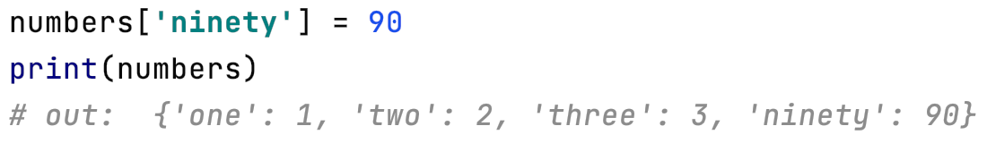
Data structures: dictionaries
Dictionaries are flexible mappings of keys to values
can be created via a comma-separated list of key:value pairs within curly braces:
Items are accessed and set via the indexing syntax used for lists and tuples, except here the index is not a zero-based order but valid key in the dictionary:
New items can be added to the dictionary using indexing:
Notes:
<number>

Slide 36
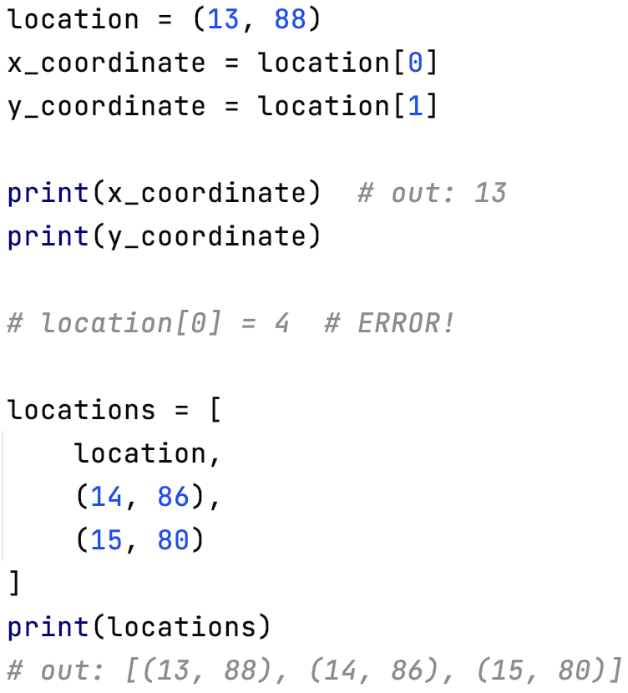
Data structures cont.: immutability
All the data structures we have looked at are mutable
Tuples exemplify immutability
Typically, we have:
Lists for homogeneous data sequences (e.g., numbers, ingredients, names)
But tuples are ideal for heterogeneous data structures (where entries have different meanings - for example, coordinates)
Note: List’s tuples are immutable, but the list itself is mutable
Notes:
<number>

Slide 37
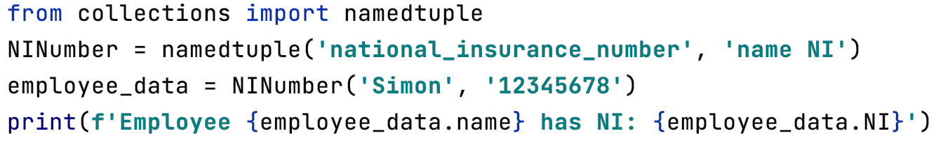
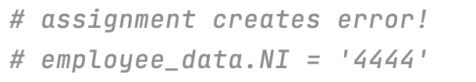
Data structures cont.
Namedtuple is handy, but also immutable
Namedtuple is a factory function for making a tuple class
In the example, NINumber becomes a factory function that can encapsulate data from any employee
Notes:
<number>

Slide 38
This forces us to think about a core programming concept: classes…
Notes:
<number>

Slide 39
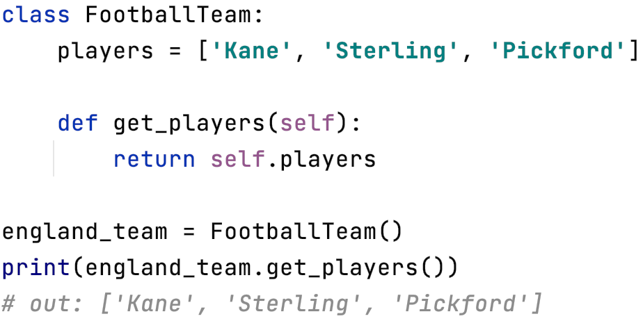
Very brief introduction to classes
Class = code template (like previously seen factory function)
Notes:
<number>

Slide 40
Ok… but how is this more interesting than a list?
Notes:
<number>

Slide 41
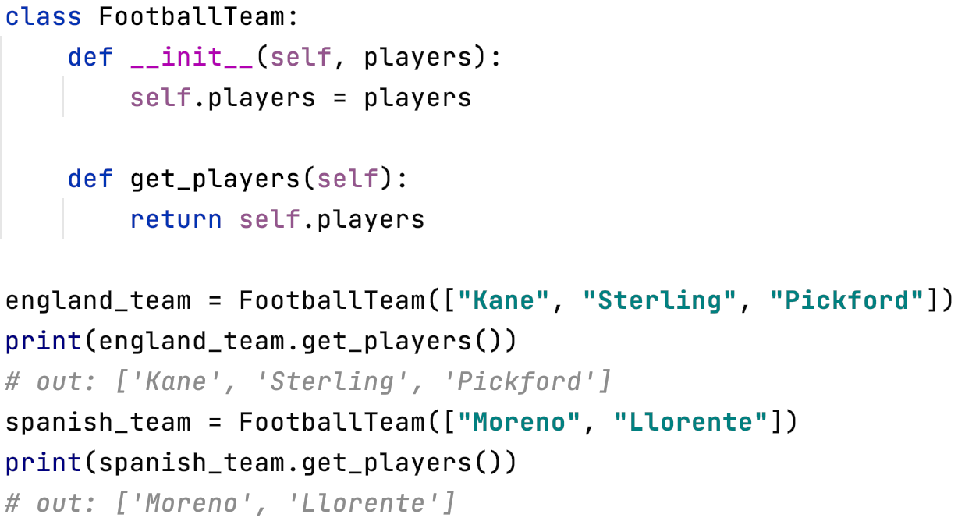
Very brief introduction to classes
We can generalise the template
Code reusability
Notes:
<number>

Slide 42
Fine… but doesn’t this lack flexibility?
Notes:
<number>

Slide 43
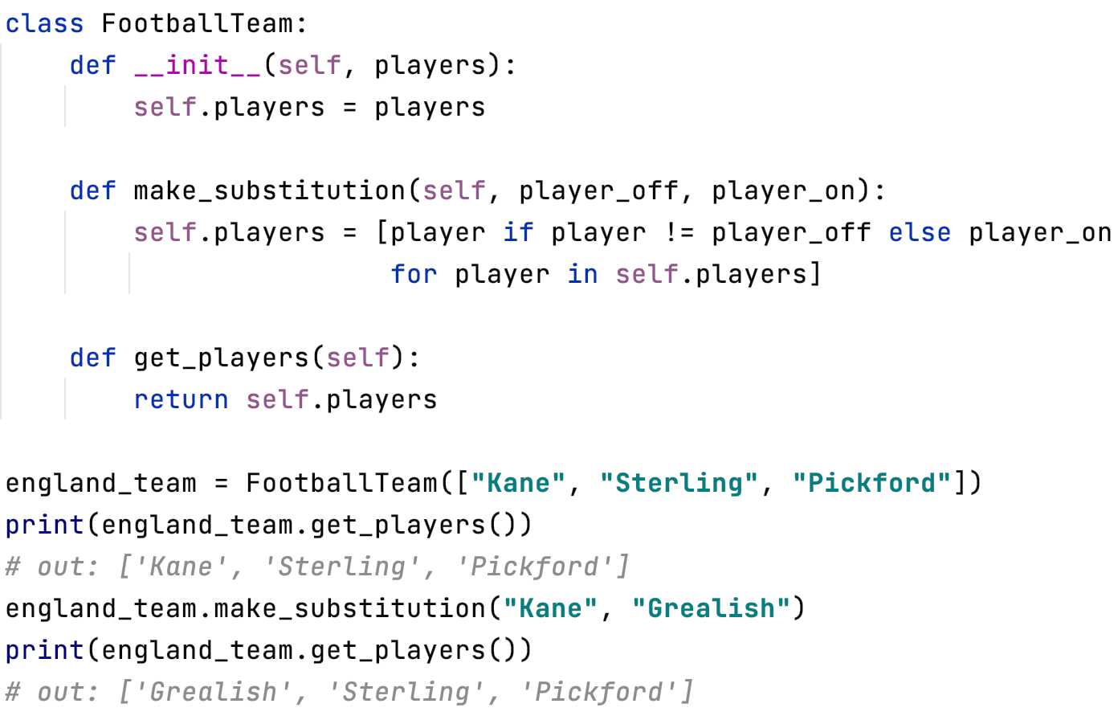
Very brief introduction to classes
We can encapsulate complexity
Notes:
<number>

Slide 44
Exercises
Ask us questions!
We’re very happy to setup breakout rooms upon request
Notes:
<number>

Slide 45
Thank you!
Feedback would really be appreciated: https://bit.ly/arc_trainingfeedback
Other training courses at ARC
RSE support
Notes:
<number>

Slide 46
Solutions to the exercises can be found here:
https://colab.research.google.com/github/DurhamARC/Intermediate-Python/blob/main/exercises/intermediate_python_exercises_solutions.ipynb

Slide 47

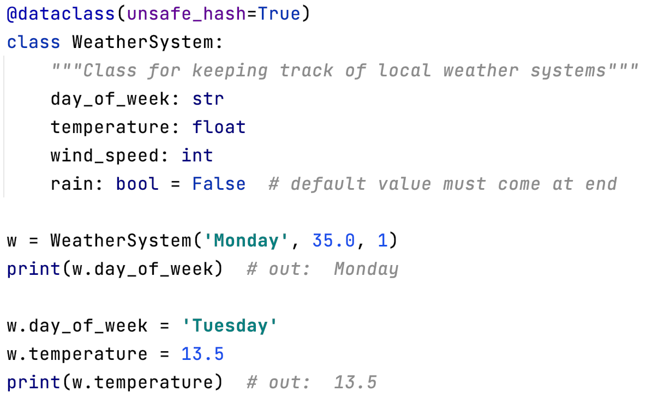
Data structures cont.: mutable alternatives
Same API as namedtuple, but mutable
Adding member functions to this dataclass is also possible
Notes:
<number>

